Slide 1
Survey of Activities and Computer Science Outcomes
Nathan Mixon, Peter Link, Logan Ferguson, Chamberlain Gibson, Justin Pike
Advisor: Dr. Sean Hayes
04/16/24

Slide 2
Background Overview
• Computer science is challenging yet essential.
• Previous research has identified aptitude tests as a predictor of future results.
• This study identifies the effects of extracurricular activities on academic success in the computer science degree.
1

Slide 3
Purpose
To help ensure students are aware of how different workloads of extracurricular activities can affect their grades
To aid professors in visualizing where department resources can be best utilized.
To refine our methodology for future insights.
4

Slide 4
Procedure
Gathered a list of relevant questions
Created a questionnaire with Microsoft Forms
Included informed consent page
Distributed through blackboard announcements
Sent to CS professors
2

Slide 5
Questions
Why they chose to participate
Motivations for continuing participation
Number of activities and time spent
Projects outside of academic setting
3

Slide 6
Participants
Voluntary and self-professed
40 total participants
33 Males and 7 Females
All are CSU students
14 seniors and 9 freshman
4

Slide 7
Results
Very few significant results were found.
Need more participants to draw more conclusive answers
Size between groups is too small.
5

Slide 8
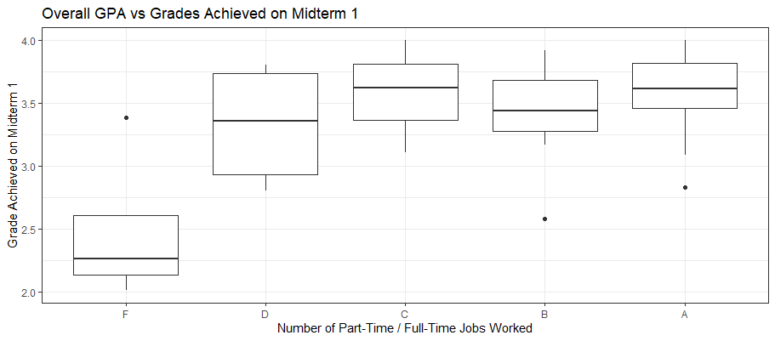
Overall GPA vs Midterm Grade
GPA
Midterm Grade
Notes:
Although, not the focus of the research, we do have this.
Residuals: Min 1Q Median 3Q Max -0.85829 -0.20148 0.02397 0.23637 0.90340 Coefficients: Estimate Std. Error t value Pr(>|t|) (Intercept) 2.4797 0.1980 12.522 4.38e-14 *** midterm_levelsD 0.8457 0.2657 3.183 0.003170 ** midterm_levelsC 1.0955 0.3025 3.621 0.000971 *** midterm_levelsB 0.9599 0.2312 4.151 0.000219 *** midterm_levelsA 1.1074 0.2229 4.969 2.02e-05 *** --- Signif. codes: 0 ‘***’ 0.001 ‘**’ 0.01 ‘*’ 0.05 ‘.’ 0.1 ‘ ’ 1 Residual standard error: 0.3961 on 33 degrees of freedom Multiple R-squared: 0.4388, Adjusted R-squared: 0.3708 F-statistic: 6.452 on 4 and 33 DF, p-value: 0.0005969

Slide 9
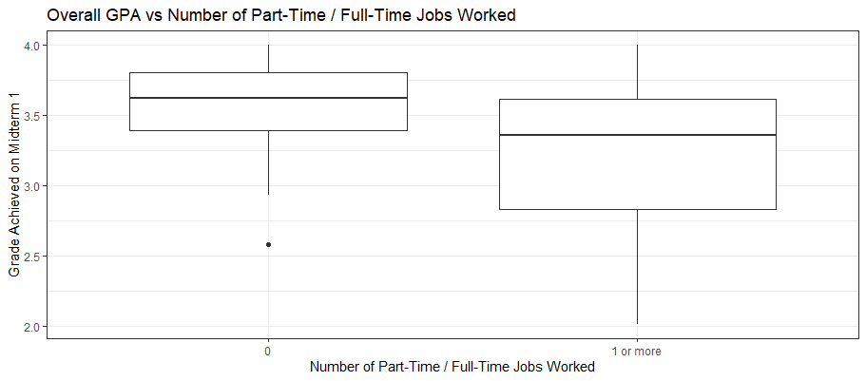
Overall GPA vs Number of Part-Time / Full-Time Jobs Worked
GPA
Notes:
*Note* GPA vs Number of Hours worked was also extremely close to being statistically significant with a negative coorelation.
Residuals: Min 1Q Median 3Q Max -1.19454 -0.15711 0.07999 0.27784 0.79336 Coefficients: Estimate Std. Error t value Pr(>|t|) (Intercept) 3.5429 0.1039 34.098 <2e-16 *** pt_ft_job_amt_levels1 or more -0.3363 0.1553 -2.165 0.0371 * --- Signif. codes: 0 ‘***’ 0.001 ‘**’ 0.01 ‘*’ 0.05 ‘.’ 0.1 ‘ ’ 1 Residual standard error: 0.4762 on 36 degrees of freedom Multiple R-squared: 0.1152, Adjusted R-squared: 0.09059 F-statistic: 4.686 on 1 and 36 DF, p-value: 0.03712

Slide 10
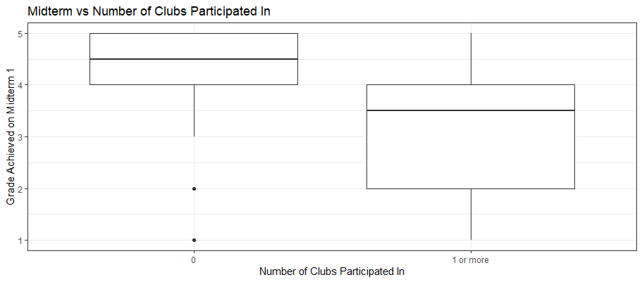
Midterm vs Number of Clubs Participated In
5 = A
4 = B
3 = C
2 = D
1 = F
Notes:
Residuals: Min 1Q Median 3Q Max -3.1250 -1.0714 0.4018 0.8750 1.9286 Coefficients: Estimate Std. Error t value Pr(>|t|) (Intercept) 4.1250 0.2669 15.454 <2e-16 *** clubs_amt_levels1 or more -1.0536 0.4397 -2.396 0.0219 * --- Signif. codes: 0 ‘***’ 0.001 ‘**’ 0.01 ‘*’ 0.05 ‘.’ 0.1 ‘ ’ 1 Residual standard error: 1.308 on 36 degrees of freedom Multiple R-squared: 0.1375, Adjusted R-squared: 0.1136 F-statistic: 5.74 on 1 and 36 DF, p-value: 0.0219

Slide 11
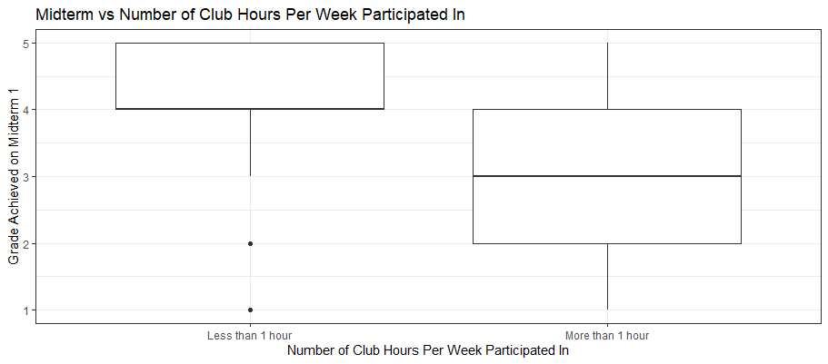
Midterm vs Hours Per Week Spent on Clubs
5 = A
4 = B
3 = C
2 = D
1 = F
Notes:
Residuals: Min 1Q Median 3Q Max -3.12 -1.00 -0.06 0.88 2.00 Coefficients: Estimate Std. Error t value Pr(>|t|) (Intercept) 4.1200 0.2596 15.872 <2e-16 *** clubs_hrs_levelsMore than 1 hour -1.1200 0.4438 -2.524 0.0162 * --- Signif. codes: 0 ‘***’ 0.001 ‘**’ 0.01 ‘*’ 0.05 ‘.’ 0.1 ‘ ’ 1 Residual standard error: 1.298 on 36 degrees of freedom Multiple R-squared: 0.1503, Adjusted R-squared: 0.1267 F-statistic: 6.369 on 1 and 36 DF, p-value: 0.01617

Slide 12
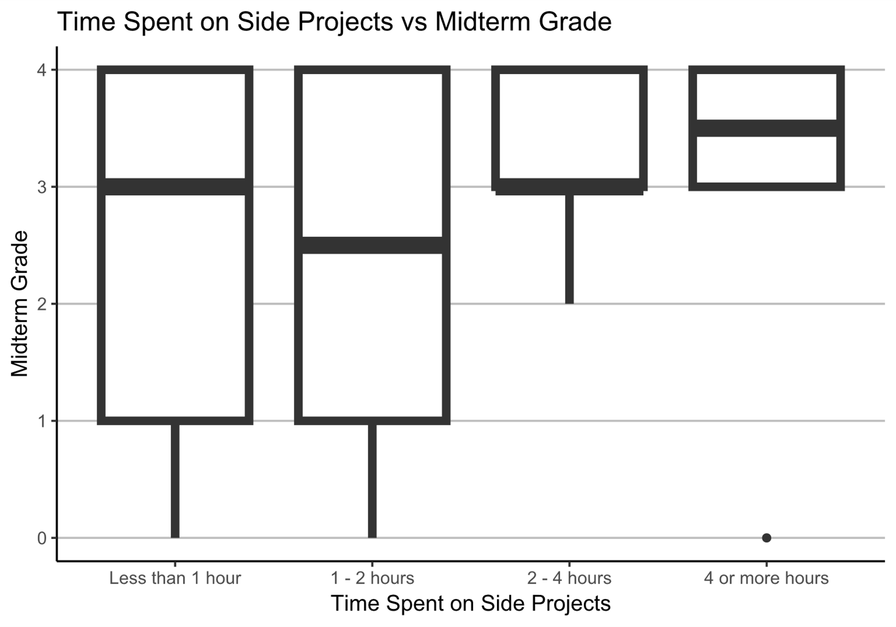
Weekly Time Spent on Side Projects vs Midterm Grade
9
4
4 = A
3 = B
2 = C
1 = D
0 = F
16
11

Slide 13
Discussion/Recommendations for Students
Participation in extra-curricular activities must be balanced with the time commitment itself
Be cautious of how much time you spend on clubs
Having a job can impact your academic performance
6

Slide 14
Recommendation for Future Studies
Refine questionnaire
Continuous survey of students
Quantify responses as much as possible
Reassessment after final grades
Notes:
Quantify responses as much as possible – Make the respondents provide full answers when it comes to numbers. Don’t box it or categorize it in. Numbers over Categories

Slide 15
References
Ashok Subramanian and Kailash Joshi. 1996. Computer Aptitude Tests as Predictors of Novice Computer Programmer Performance. Journal of Information Technology Management, VII Numbers 1 & 2.
Beth Simon and Brian Hanks. 2008. First-year students' impressions of pair programming in CS1. J. Educ. Resour. Comput. 7, 4, Article 5 (January 2008), 28 pages. https://doi.org/10.1145/1316450.1316455
Fredricks, J. A. (2012). Extracurricular Participation and Academic Outcomes: Testing the Over-Scheduling Hypothesis. Journal of Youth and Adolescence, 41(3), 295–306. https://doi.org/10.1007/s10964-011-9704-0
James Harris. 2014. Testing programming aptitude in introductory programming courses. J. Comput. Sci. Coll. 30, 2 (December 2014), 149–156.
Leland Beck and Alexander Chizhik. 2013. Cooperative learning instructional methods for CS1: Design, implementation, and evaluation. ACM Trans. Comput. Educ. 13, 3, Article 10 (August 2013), 21 pages. https://doi.org/10.1145/2492686
Linda Ott, Briana Bettin, and Leo Ureel. 2018. The impact of placement in introductory computer science courses on student persistence in a computing major. In Proceedings of the 23rd Annual ACM Conference on Innovation and Technology in Computer Science Education (ITiCSE 2018). Association for Computing Machinery, New York, NY, USA, 296–301. https://doi.org/10.1145/3197091.3197139
Lisa L. Lacher, Albert Jiang, Yu Zhang, and Mark C. Lewis. 2017. Aptitude and Previous Experience in CS1 Classes. International Conference Frontiers in Education: CS and CE | FECS’17 |
Margaret Ellis, Liesl Baum, Kimberly Filer, and Stephen H. Edwards. 2021. Experience Report: Exploring the Use of CTF-based Co-Curricular Instruction to Increase Student Comfort and Success in Computing. In Proceedings of the 26th ACM Conference on Innovation and Technology in Computer Science Education V. 1 (ITiCSE '21). Association for Computing Machinery, New York, NY, USA, 303–309. https://doi.org/10.1145/3430665.3456376
7

Slide 16
Questions?

